Slide 1

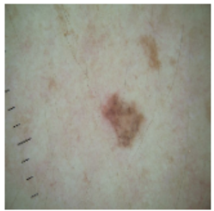
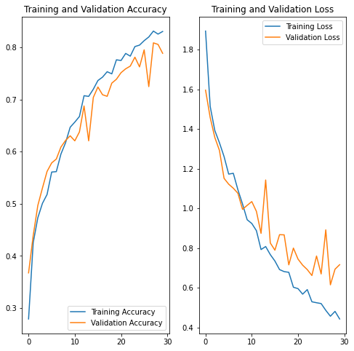
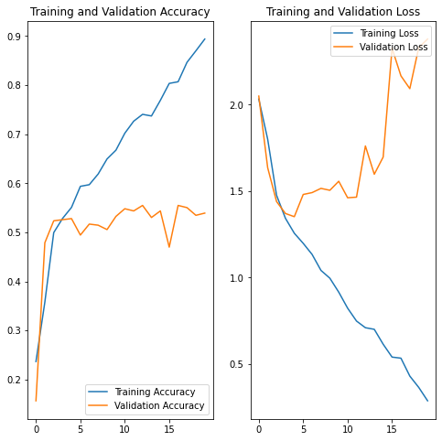
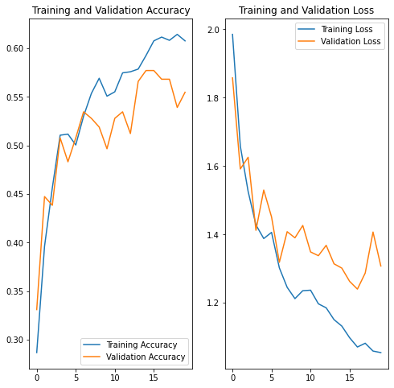
MIPT, Dolgoprudny, Russia
Advanced Combinatorics
Surajit Das. (1st Year Masters) E-mail: surajit.das@phystech.edu
Intelligent System for Detecting Skin Cancer
RELEVANCE AND MOTIVATION
DESCRIPTION OF THE ALGORITHM DETAILS
EXPERIMENTAL RESULTS
Melanoma is a type of cancer that can be deadly if not detected early. It accounts for 75% of skin cancer deaths.
Fig: melanoma
An intelligent diagnostic system for detecting Melanoma significantly can impact the life of remote villagers in poor countries who are suffering from lack of dermatologists.
Besides this it can potentially minimize the manual effort in diagnosis and It can issue the alert to the busy dermatologists about the presence of melanoma.
Data Reading/Data Understanding → Defining the path for train and test images. The data set contains the following diseases:
(i) Actinic keratosis, (ii) Basal cell carcinoma, (iii) Dermatofibroma,
(iv) Melanoma, (v) Nevus, (vi) Pigmented benign keratosis, (vii) Seborrheic keratosis, (viii) Squamous cell carcinoma, (ix) Vascular lesion
Dataset Creation→ Create train & validation dataset from the train directory with a batch size of 32. Also, make sure you resize your images to 180*180.
Dataset visualisation → Create a code to visualize one instance of all the nine classes present in the dataset.
Model Building & training:
Create a CNN model, which can accurately detect 9 classes present in the dataset. While building the model rescale images to normalize pixel values between (0,1).
Choose an appropriate optimizer and loss function for model training.
Train the model for ~20 epochs.
Write your findings after the model fit, see if there is evidence of model overfit or underfit
Data augmentation: Choose an appropriate data augmentation strategy to resolve underfitting/overfitting
Model Building & training on the augmented data:
Create a CNN model, which can accurately detect 9 classes present in the dataset. While building the model rescale images to normalize pixel values between (0,1).
Choose an appropriate optimiser and loss function for model training.
Train the model for ~20 epochs
Class distribution: Examine the current class distribution in the training dataset to find the lowest distribution class & highest distribution of class.
Handling class imbalances: Rectify class imbalances present in the training dataset with Augmentor library.
Model Building & training on the rectified class imbalance data:
Create a CNN model, which can accurately detect 9 classes present in the dataset. While building the model rescale images to normalize pixel values between (0,1).
Choose an appropriate optimiser and loss function for model training
Train the model for ~30 epochs
Finally, the problem of overfitting is rectified. The rebalance helps to increase training and validation accuracy (near about 80%).
TASK STATEMENT
CONCLUSIONS AND DEVELOPMENT PROSPECTS
CNN (Convolutional Neural Network) driven model for detection of melanoma accurately is a multiclass classification model using a custom convolutional neural network in tensorflow. It is built up based on the dataset taken from International Skin Imaging Collaboration (ISIC).
All images were sorted according to the classification taken with ISIC, and all subsets were divided into the same number of images, with the exception of melanomas and moles, whose images are slightly dominant.
Finally, the problem of overfitting is rectified. The rebalance helps to increase training and validation accuracy.
The Accuracy found is 80%
In order to increase the performance of the model metaheuristic optimization with evolutionaly algorithm (Genetic Algorithm) can be used.
Some transfer learning approaches involving VGG16, VGG19, GoogleNet, ResNetV2 etc. can be tried.
PROPOSED METHOD/ALHORITHM
EXPERIMENTAL RESULTS
REFERENCES
START
Data Collection
It is found that the model goes overfitting. The graph shows the training accuracy is very high compare to the validation accuracy.
[1] R. R. Senthil Kumar; Amarjeet Singh; Sparsha Srinath; Nimal Kurien Thomas. (2022). Skin Cancer Detection using Deep Learning. https://doi.org/10.1109/ICEARS53579.2022.9751826
[2] Khalid M. Hosny; Mohamed A. Kassem; Mohamed M. Foaud (2018). Skin Cancer Classification using Deep Learning and Transfer Learning. https://doi.org/10.1109/CIBEC.2018.8641762
[3] Catarina Barata; Jorge S. Marques (2019). Deep Learning For Skin Cancer Diagnosis With Hierarchical Architectures. https://doi.org/10.1109/CIBEC.2018.8641762
[4] Teck YanTan, Li Zhang, Chee PengLim. (2019). Intelligent skin cancer diagnosis using improved particle swarm optimization and deep learning models. https://doi.org/10.1016/j.asoc.2019.105725
[5] Hardik Nahata & Satya P. Singh (2020). Deep Learning Solutions for Skin Cancer Detection and Diagnosis. https://doi.org/10.1007/978-3-030-40850-3_8
Train Test Data Preparation
Dataset Visualization
Model Building on Imbalanced Dataset
Data Augmentation
Class imbalance can have a detrimental effect on the final model quality. Result of a sanity check it about the distribution of classes in the data.
seborrheic keratosis (77 # Samples)
pigmented benign keratosis (462 # Samples)
Model Building on Augmented Dataset
Inspecting Class Distribution
Handling class imbalances
END
Building Final Model

